Slide 1

1st National conference on Emerging Trends in Computer Science and Technology In-2026 Buddha Institute of Technology GIDA, Gorakhpur Date of Conference: 9th April-11th April,2026
Digital Queue Manager
Name: Mahi Chaudhary
2405250130035
Branch: Information Technology
Year:2nd
^{Guide name: Ritesh Sharma}
^{(Assistant Professor)}

Slide 2
Contents
Introduction
Problem Statement
Objectives
Literature Survey
Proposed Solution / Methodology
Results & Analysis
Conclusion & Future Work
Acknowledgements
References

Slide 3
Introduction
Importance
It reduces patient waiting time, enhances hospital workflow, and ensures better utilization of medical resources. The system significantly improves patient experience and decision-making for healthcare providers.
• Background
Hospitals often face challenges in managing patient flow efficiently due to manual queue systems. Long waiting times, lack of real-time updates, and overcrowding lead to patient dissatisfaction and operational inefficiencies.
Context
It incorporates patient and doctor dashboards, real-time queue updates, multilingual support, and an AI chatbot for basic health assistance.

Slide 4
Problem Statement
Current Gap
Patients often have to wait in long, unorganized lines without any clear information about their turn or waiting time. There is no proper system to handle emergency cases or prioritize patients effectively.
Why it Matters
These inefficiencies lead to increased patient frustration, overcrowding in hospitals, and poor time management for both patients and doctors. In critical situations, delays can directly impact patient health outcomes.

Slide 5
Objectives
• Objective 1
• Objective 2
To provide real-time queue tracking and prioritize emergency cases for efficient patient handling.
• Objective 3
To enhance patient experience using AI chatbot assistance and multilingual support.
To develop a digital queue management system that reduces patient waiting time and improves hospital workflow.

Slide 6
Literature Survey
Author
Diwakar Gupta & Brian Denton(2008)
Muhammad Ahmad Baballe et al.
S. Gunasekaran et al.(2022)
Proposed Work
Token-based queue system
Cloud-based queue management.
Digital healthcare system to improve efficiency and patient services.
Limitations
No real-time tracking, no emergency priority.
No AI assistance for patients.
No multilingual support.

Slide 7
Proposed Solution / Methodology
Approach
Combine multiple features into one integrated platform
Focus on user-friendly and
simple design
Provide real-time updates
and automation
Ensure privacy using AI chatbot interaction
Tools
HTML, CSS, JavaScript
Web Speech API (voice alerts)
Techniques
Real-time data update using JavaScript
Chatbot interface design
Responsive UI/UX design
Data storage using local
storage (frontend level)

Slide 8
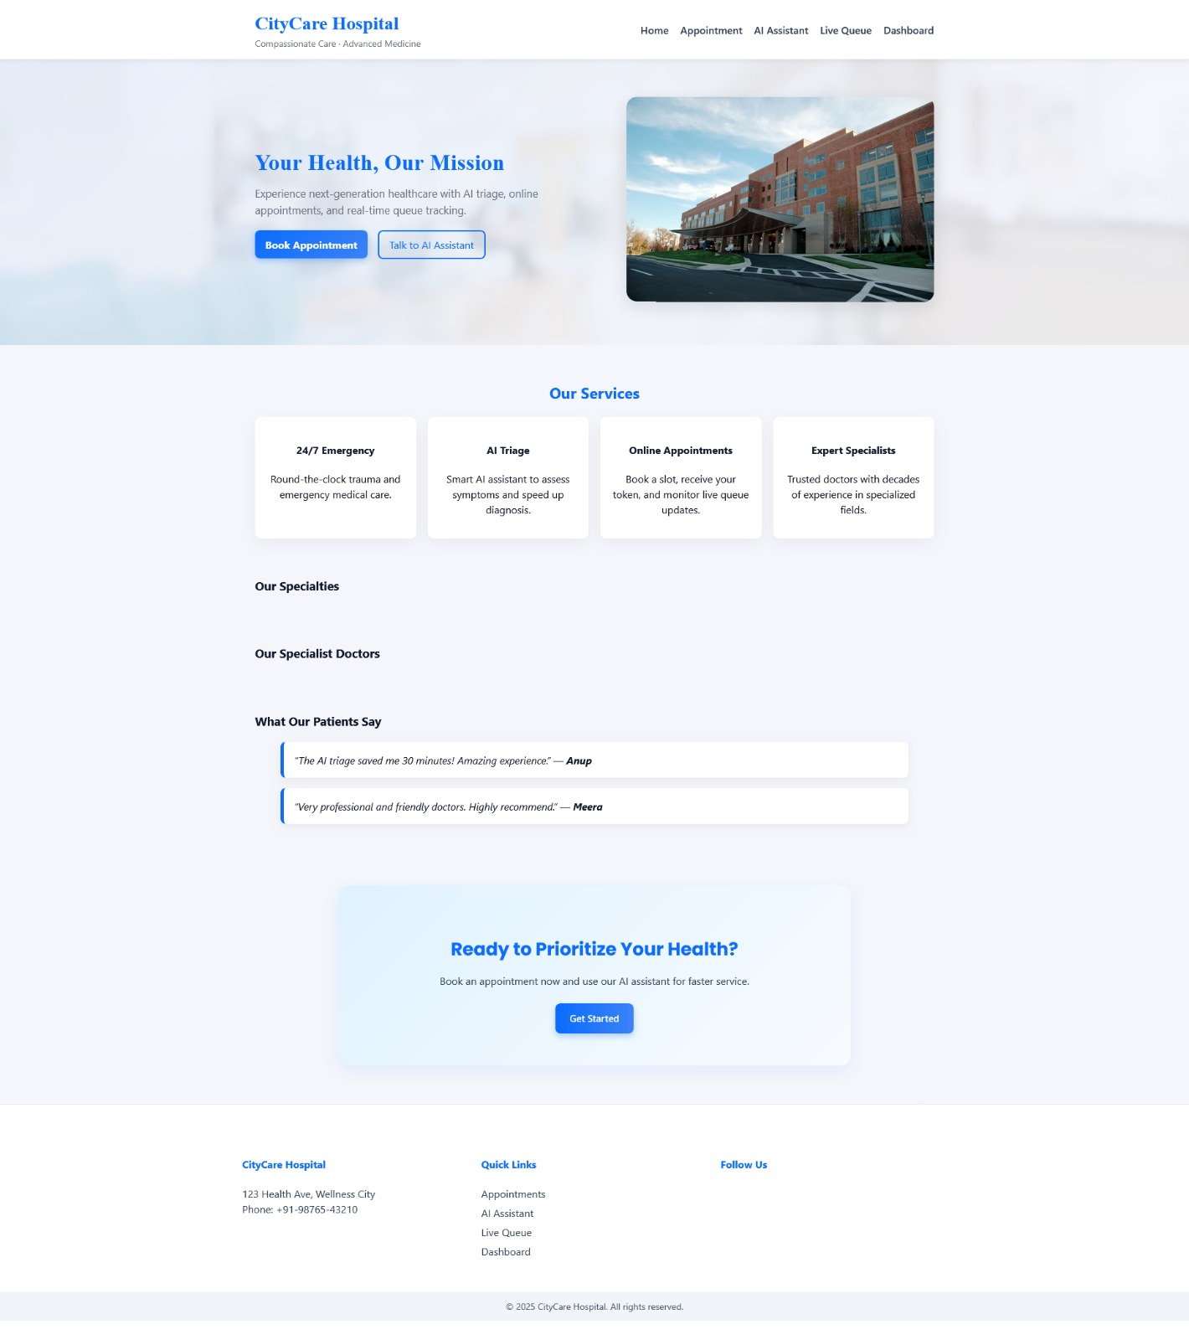
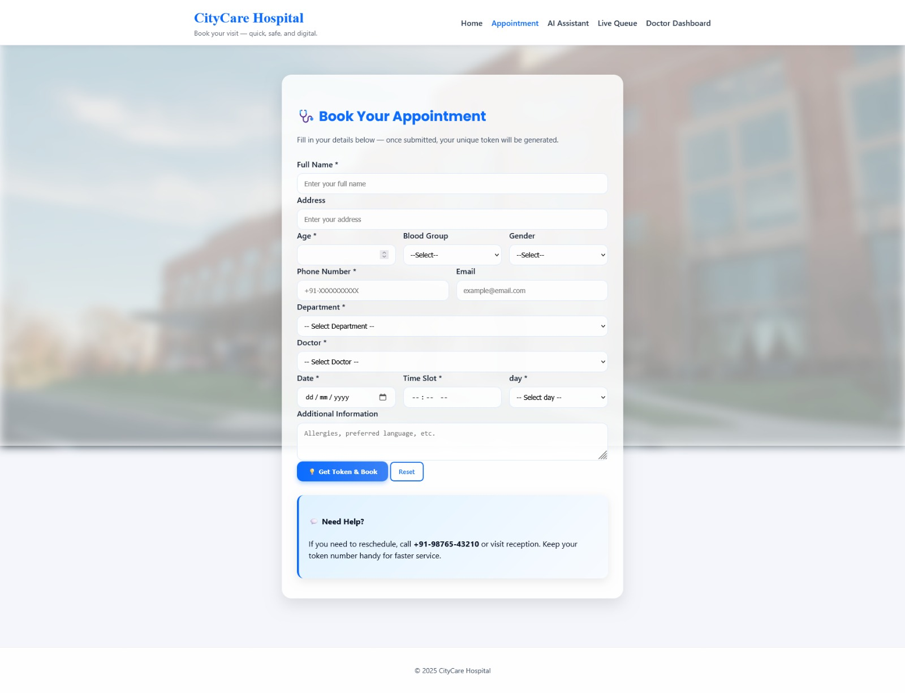
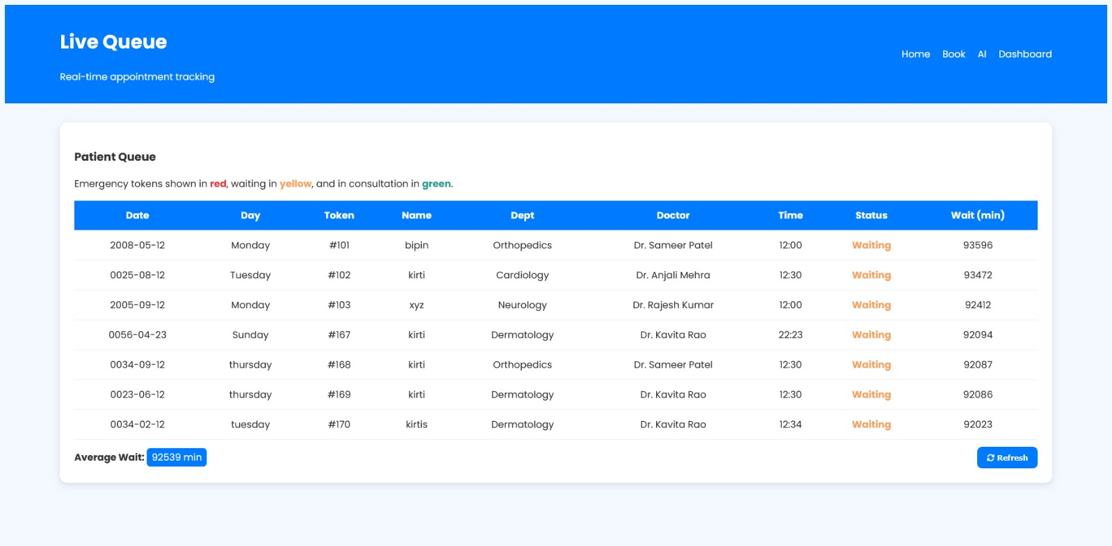
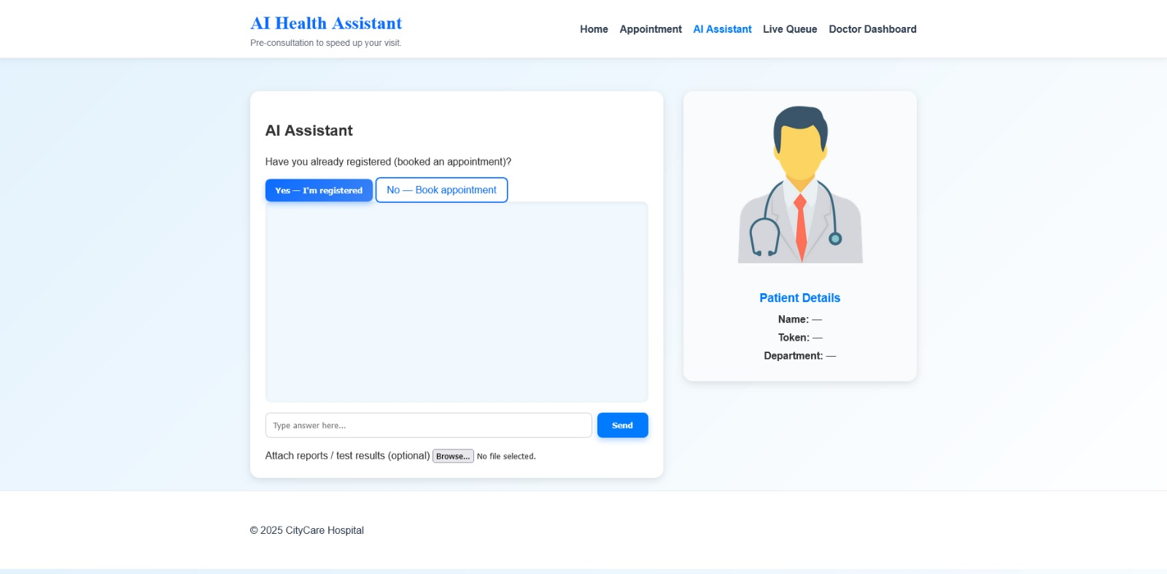

Slide 9
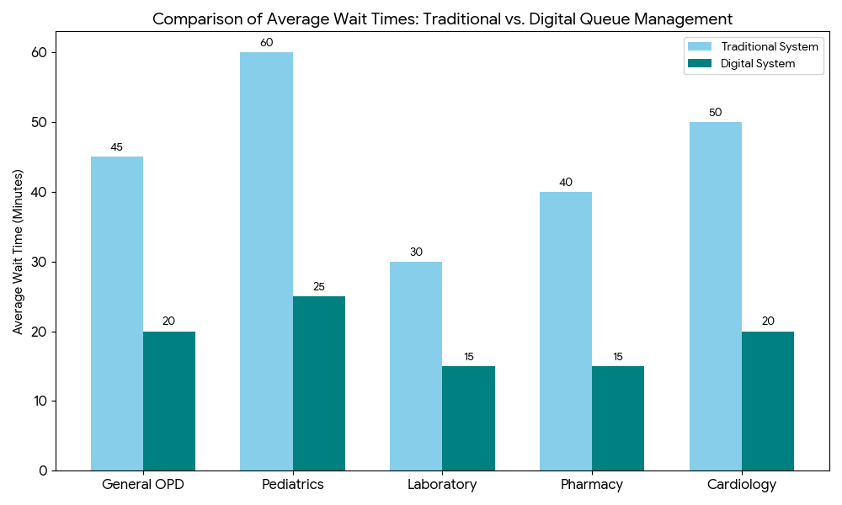
Results & Analysis Graph

Slide 10
Key Outcomes
• Significant reduction in patient waiting time. • Better handling of emergency cases through priority system. • Enhanced patient experience with real-time updates and AI support. • Increased transparency and reduced overcrowding.
Comparisons
Parameters Before System After system
Waiting Time High Low Queue Management Manual Automated Real-time Updates Not Available Available Emergency Handling Not Efficient Priority based
Patient Satisfaction Moderate High Transparency Low High AI Assistance Not Available Available Multilingual Support Not Available Available

Slide 11
Conclusion & Future Work
• Summary
• Key takeaway
The Digital Queue Management System successfully improves hospital efficiency by reducing waiting time and enabling real-time queue tracking. It integrates patient and doctor dashboards, emergency prioritization, multilingual support, and an AI chatbot to enhance overall healthcare experience.
• Reduces patient waiting time and overcrowding. • Improves hospital workflow and resource utilization. • Enables real-time tracking and better transparency. • Enhances patient experience using AI and multilingual support.

Slide 12
Acknowledgements
• Guide
• Institution
I would like to thank my institution(BUDDHA INSTITUTE OF TEECHNOLOGY) for providing the necessary resources, facilities, and a supportive environment to successfully complete this project.
I sincerely express my gratitude to my project guide Mr. Ritesh Sharma for their valuable guidance, continuous support, and encouragement throughout the development of this project.

Slide 13
References Diwakar Gupta and brian https://doi.org/1.5281/zenodo.711761 Muhammad Ahmad Baballe https://www.researchgate.net/371661 S. Gunasekaran https://ph01.tcithaijo.org/TNIJournal/2436

Slide 14
THANK YOU

